Slide 1
Introduction to NoSQL Databases

Slide 2
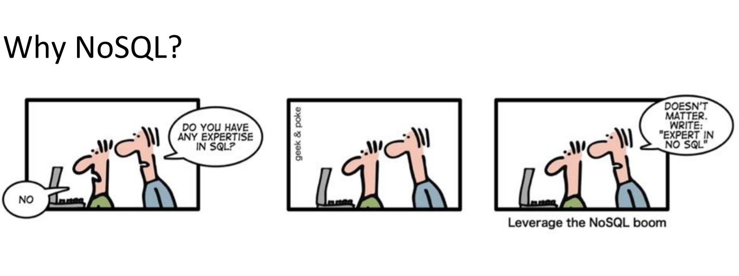

Slide 3
Don't Discount the Past: Relational Databases
To date, the most prevalent databases are still relational databases
For many applications, they are still preferable to NoSQL databases
But for others, NoSQL offers an advantage

Slide 4
NoSQL Databases
NoSQL Databases are non-relational databases
SQL is not used to query these databases
While they have surged in popularity, they have been around since the 1960's
Drivers of the popularity include growth of the cloud, and the variety & volume of data - log data - electronic medical records
- internet of things
- video
- images
- waves
- sound files

Slide 5
The Limitations of Relational Database Management Systems (RDBMS)
• Not all data can be expressed in relational manner
RDBMS can model data ONLY in the form of tabular relations Data can be expressed in other structures such as: > key-value > wide column > graph (network) > document
• The Relational DB is sometimes too complex
• Relational DB requires schema to be mostly known in advance they can be updated, but schema changes can be painful
• Scaling the RDBMS can be hard

Slide 6
The Nature and Advantages of NoSQL Databases
NoSQL databases are primarily nonrelational or distributed databases
For some data formats (e.g., documents and data with hierarchies), NoSQL offers advantages:
More scalable
Better performance
Flexibility - data models that are easier to use
Can be easier to get started since schema doesn't need to be determined in advance

Slide 7
NoSQL Use Case
A tech company wants to scrape web pages of restaurants, and store attribute information such as:
- hours of operation
- address
- menu items
- reviews
The information content from various web sites will differ in their completeness
Some pages might have a few reviews, others might have many more
It wouldn't make sense to store data in tables with fields like review1, review2, … There might be a lot of empty cells. If we decide to save additional fields later, the schema might need to change This is very inconvenient for a relational database

Slide 8
NoSQL Use Case, contd.
The task is an excellent candidate for a NoSQL database
We want to store information attached to each restaurant: the restaurant can be the key, and the attribute information can be the value
The key-value pairs can be easily stored in JSON format

Slide 9
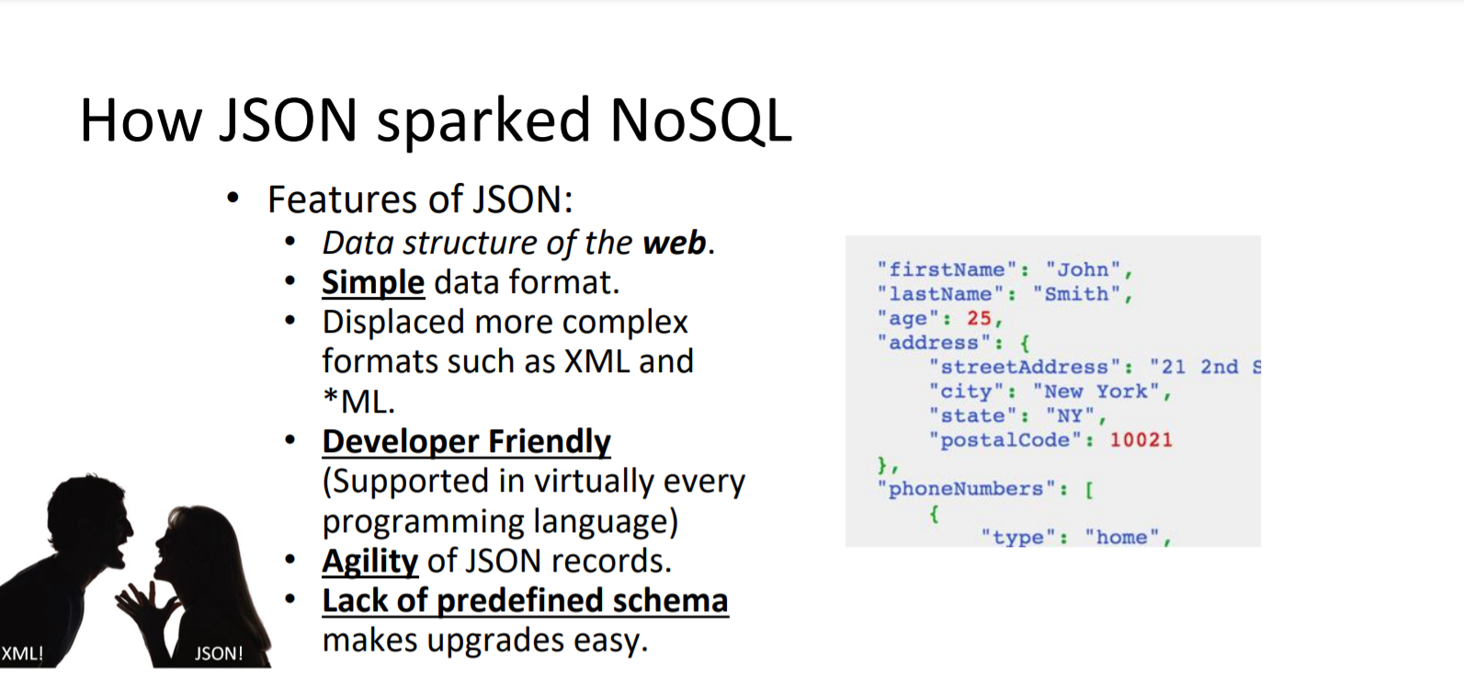
JSON in NoSQL

Slide 10
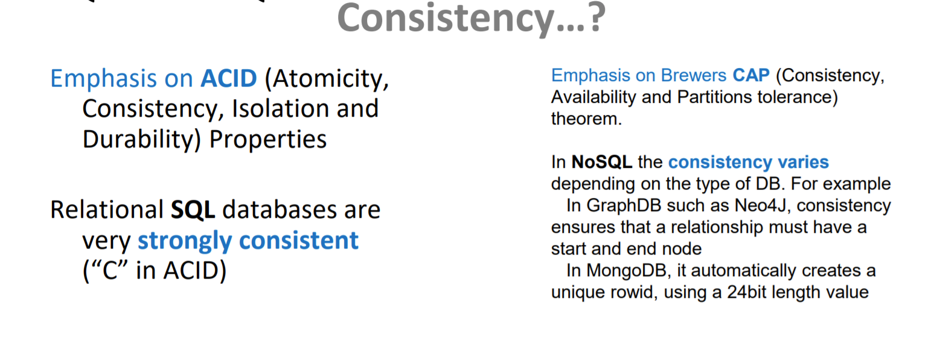
RDBMS vs NoSQL
RDBMS
NoSQL

Slide 11
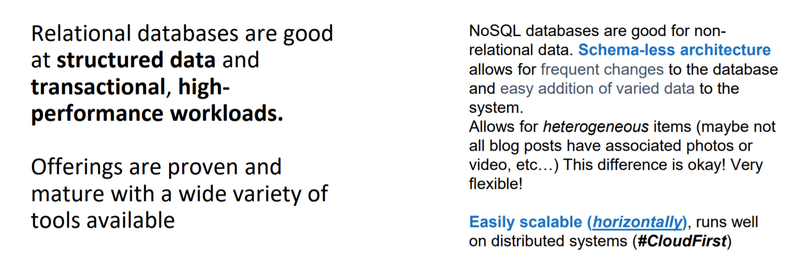
What are Relational DBs, NoSQL DBs good at?

Slide 12
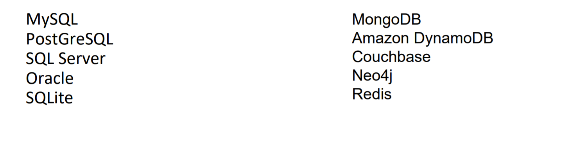
RDBMS and NoSQL Examples
RDBMS
NoSQL

Slide 13
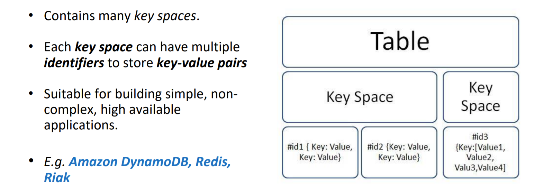
Key-Value Store DB

Slide 14
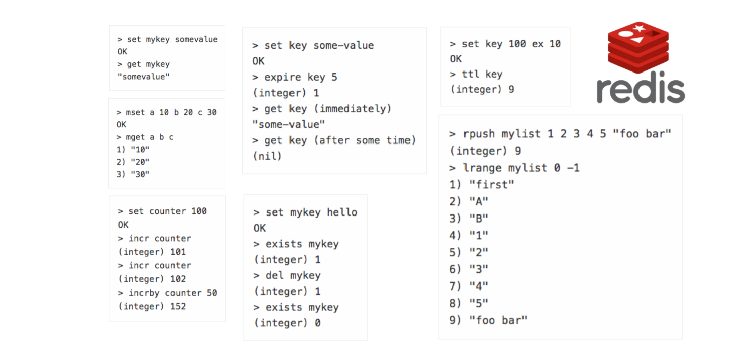
Key-Value Store DB Example: redis

Slide 15
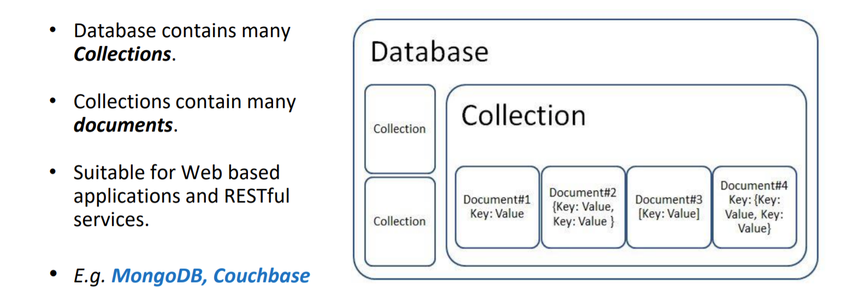
Document-Oriented DB

Slide 16
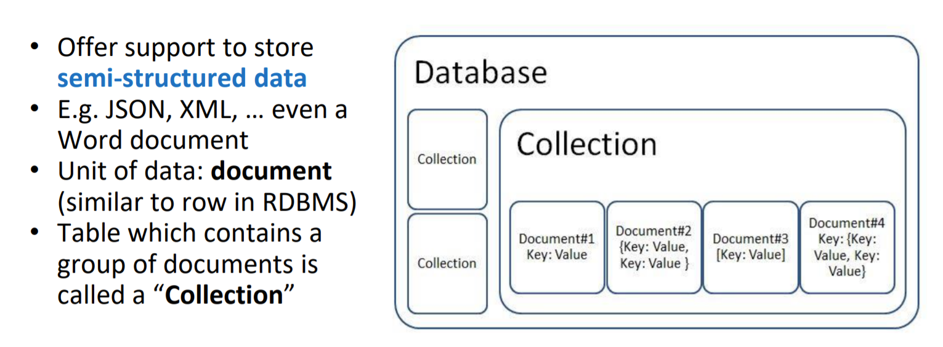
Document-Oriented DB

Slide 17
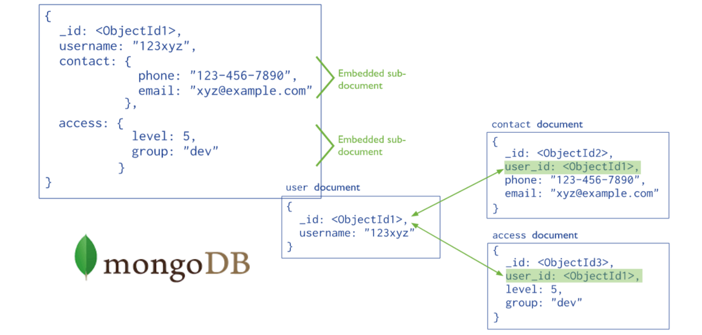
Document-Oriented DB Example: mongoDB

Slide 18
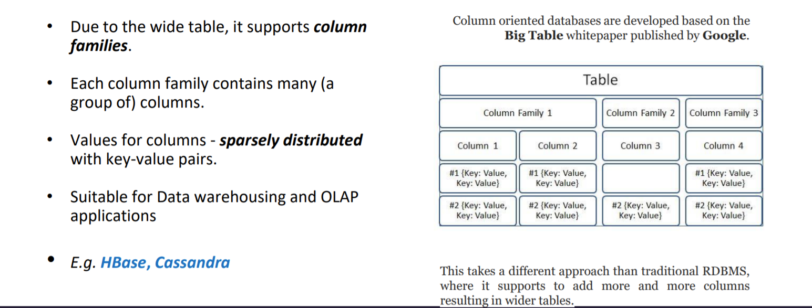
Column-Based Store

Slide 19
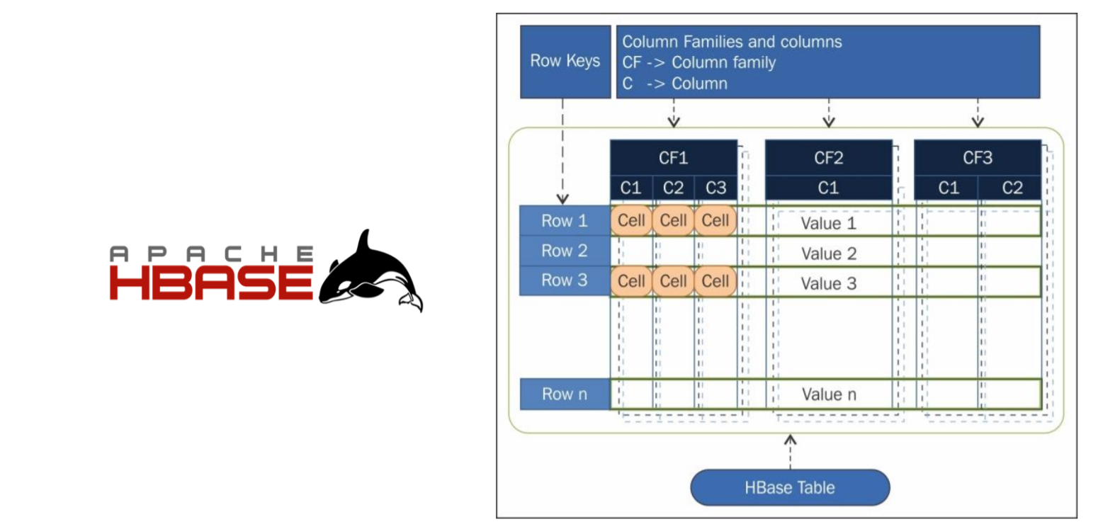
Column-Based Store DB Example: HBASE

Slide 20
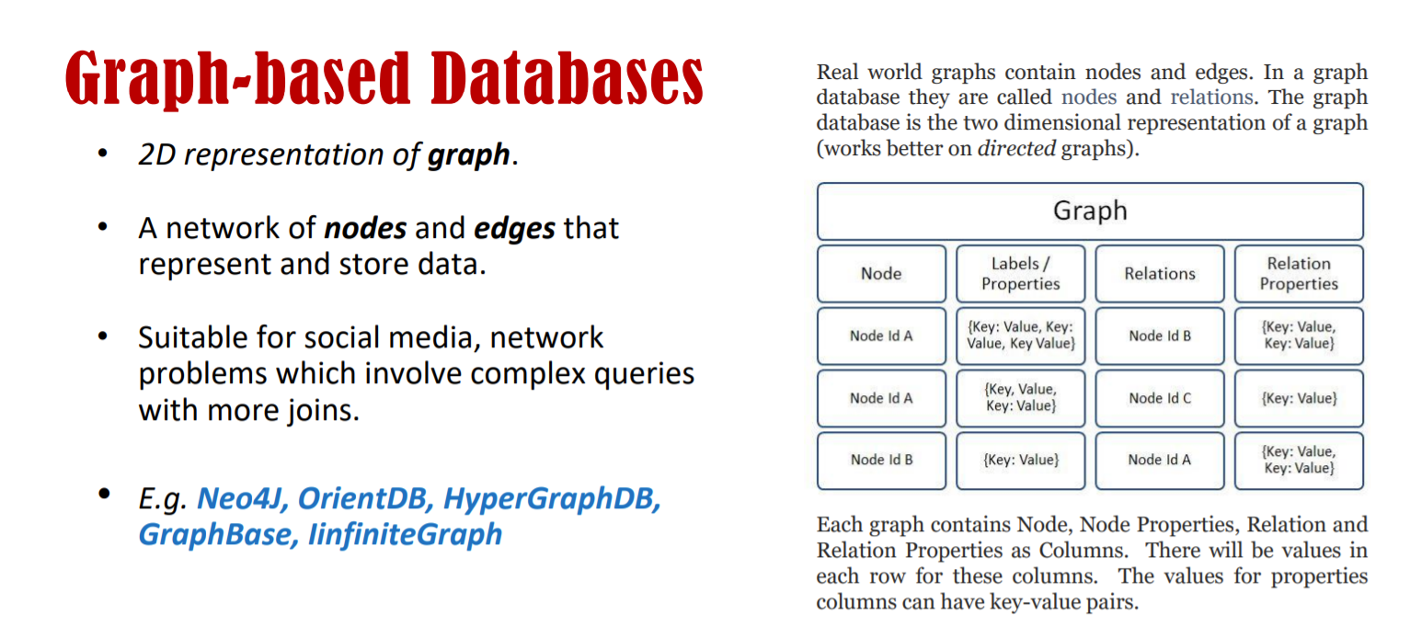

Slide 21
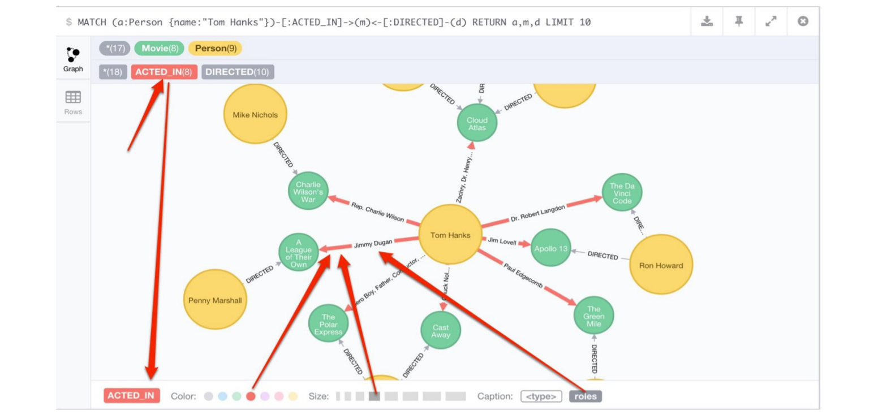
Graph-Based Databases

Slide 22
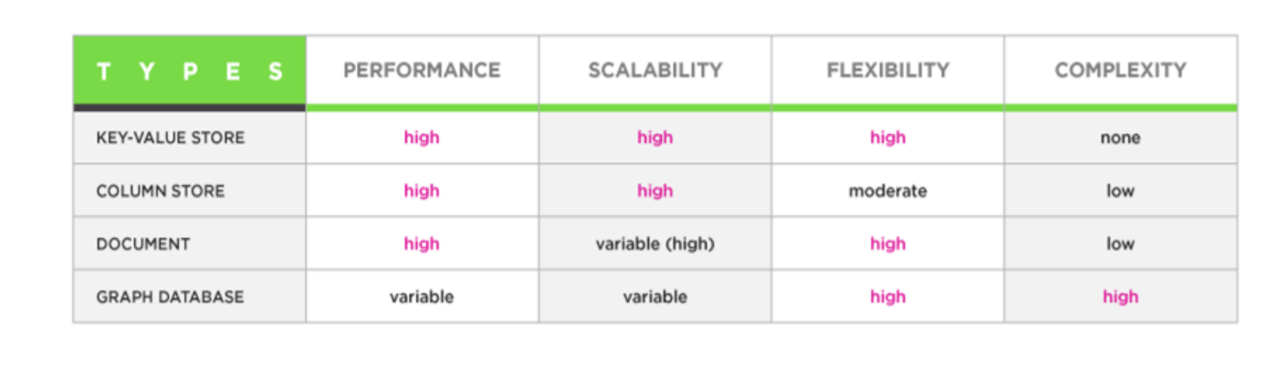
Feature Summary

Slide 23
